Slide 1
DevOpsing in a Microsoft World
Notes:
We are a 79 year company that has 1 or 2 of almost everything but most of our 3,000 servers run Windows in support of N tier Business Applications in our own datacenters.

Slide 2

“DevOps in a Microsoft shop is like a 5 hour road trip to an amusement park on the hottest day of the year”

Slide 3
Agenda:
Challenges in a “Microsoft” Enterprise
Columbia engineer interviews
Growth mindset
DevOps at Columbia 2015-2017
Deep Dive: ChatOps
Notes:
Challenges you will likely encounter as a leader
Check in with the Columbia Engineers on their experiences
Look at Growth Mindset from a couple of angles
Specific actions and outcomes at Columbia
Deep Dive into ChatOps
I hope you take away an appreciation for your role as a leader, an appreciation for the journey your teams must go through, and a desire to go on this highly rewarding journey.

Slide 4
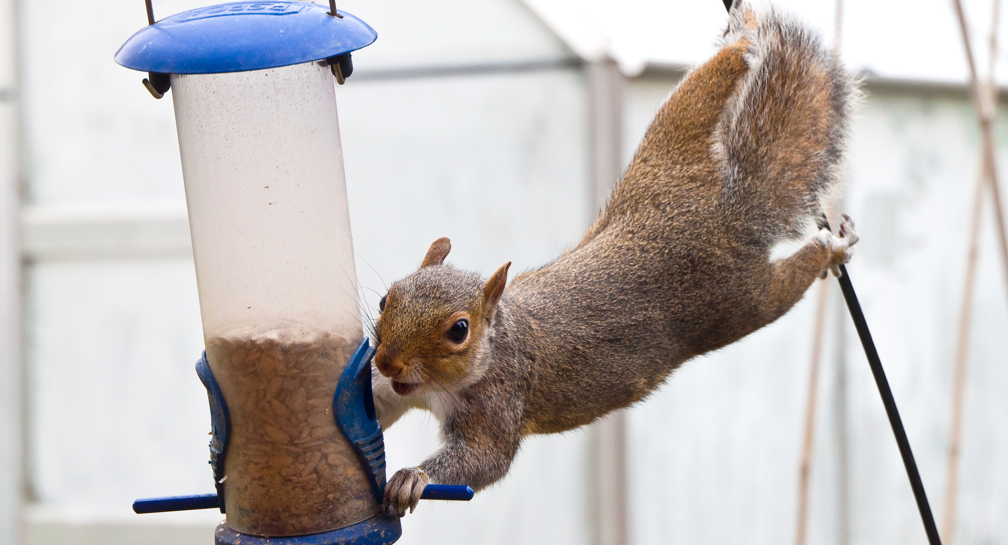
Screenshots, Monolithic tools, Closed Source, and undocumented APIs + Limited Engineering tradition
Notes:
In a typical enterprise you would expect
* Normal, rational hesitation to widespread change
* Functional silos, organizational alignment
* Typical Agile-Lean-DevOps (ALDO) challenges
In a typical Microsoft enterprise you would expect
* Monolithic tools, screenshots, “click next”
* Closed source, undocumented APIs, friction
* Reliance on vendors for direction, road mapping
* Silos encouraged by Microsoft or by certifications
At Columbia we have a Limited engineering tradition due to extensive reliance on Commercial Off The Shelf (Buy vs. Build). In fact, much of our journey would require teaching engineering practices.

Slide 5
SWOT Analysis ~2014
Strengths Vendor partnerships Exceptionally tight knit teams Expertise in storage & virtualization Strong operational background Entrepreneurial DNA Low turnover in team 99% virtualized with high availability
Weaknesses Reliance on vendors (COTS, Microsoft) Single threaded in numerous technologies Substantial legacy footprint Large population of long-lived servers Organization not “product” oriented Decentralized internal customers Low standardization / automation
Opportunities Centralized Infrastructure Engineering Under-challenged IT Pros 2 Engineers with scripting capabilities CSC 2020 ($2B → $5B)
Threats Potential disruption in retail CSC 2020 ($2B → $5B)

Slide 6

Core Challenge: Enduring DevOps transformations require a commitment to Continuous Improvement (Learning)
Notes:
Core Challenge: Enduring DevOps transformations require a commitment to Continuous Improvement (Learning)
“A learning organization is an organization skilled at creating, acquiring, and transferring knowledge and at modifying its behavior to reflect new knowledge and insights”
If you want to “do the DevOps” and don’t have a learning organization, what do you do?

Slide 7

Growth Mindset?
Notes:
Is it enough to tell your teams to have a growth mindset?
I often hear “well they are not tall enough to ride the ride” ... Take a look at that little girl, how does she feel not being able to participate?

Slide 8


Turn the Ship Around : True story of a worst to first transformation with the same crew!
Notes:
I recently discussed growth mindset with a DevOps thought leader…His opinion was to gut the organization and start over with DevOps teams.
His Admiral told him “If you need to change out some people, let me know, but I’m not interested in a lot of turnover. I don’t think that will help the crew. I think a better focus would be on working with what you’ve got.” In the end none of the sub crew was fired
This was important because it sent the message to each crew member that he wasn’t screwed up.
The challenge would be to use the same people and support team and by changing the way they interacted and behaved, dramatically increase the combat effectiveness of Santa Fe.

Slide 9
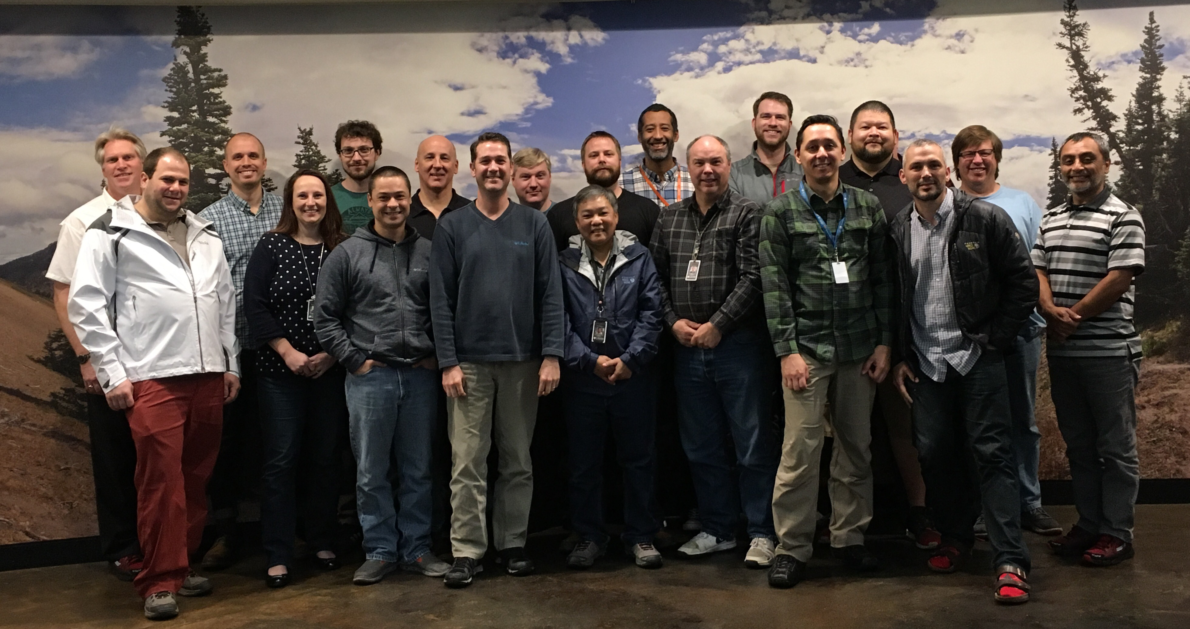
Interviews:
Describe the journey
Favorite aspect
Least favorite aspect
Advice to the 2015 you
Anticipating in next 2 years

Slide 10

“Lots of self doubt, I definitely felt like an imposter.; Eventually, I felt like I could contribute”
Notes:
The journey has included “Lots of self doubt, I definitely felt like an imposter.; Eventually, I felt like I could contribute”
“It’s been hard to ramp up due to the slew of tools, behaviors, and new ways of thinking”
The team has grown quite a bit but can regress to old ideas and mindsets; I learned quite a bit about dealing with folks I don’t agree with (as an aside, these types of situations happen more due to working more collaboratively than in the past)

Slide 11

Favorite aspect: “The encouragement to experiment (fail) without fear of punishment, especially with ChatOps”
Notes:
My favorite aspect has been: “The encouragement to experiment (fail) without fear of punishment, especially with ChatOps”
I have enjoyed expanding my sphere of responsibilities and interests by breaking down IT silos. The variety and level of activity within the team has been rejuvenating
I enjoy being on the leading edge of enterprise IT. DevOps is not new for unicorns but it is still in beginning stages in Microsoft centric enterprises.
People, Teammates, and Mentorship
Learning to ask for help;
Developing confidence

Slide 12

Least favorite aspect: “Lack of prioritization across projects, maintenance, support"
Notes:
Least favorite aspect: “Lack of prioritization across projects, maintenance, support"
Constant change… all the experiments, not enough time to go deep
Adapting to change is difficult, especially for those in the field for many years
Not being able to devote enough time to new work
Feeling lost/helpless, discomfort due to breadth of technologies we run
Windows makes it harder than it needs to be
The lack of time to experiment with technologies outside my immediate areas of responsibility has been frustrating

Slide 13

“Be prepared to disappoint someone, It could be your manager, the business, your teammate, or yourself”
Notes:
Over the next two years, you’re going to have to disappoint someone - It could be your manager, it could be the business, it could be your teammates, it could be your family, it could be yourself. You’re already at 100% and changing the way you work will seem like adding another 30% of work.
Choose wisely who you disappoint, and remember that you’re not in this transformation alone.
Spend some time assisting the business units you support to be more self-sufficient – give them the tools and permissions to help themselves so that you can focus on the true elements of infrastructure.
The near future and speed of infrastructure isn’t going to allow itself to be built and maintained by "paint by numbers" Microsoft Wizard – even MS is rapidly changing its toolsets in response to the reinvention of IT infrastructure.

Slide 14
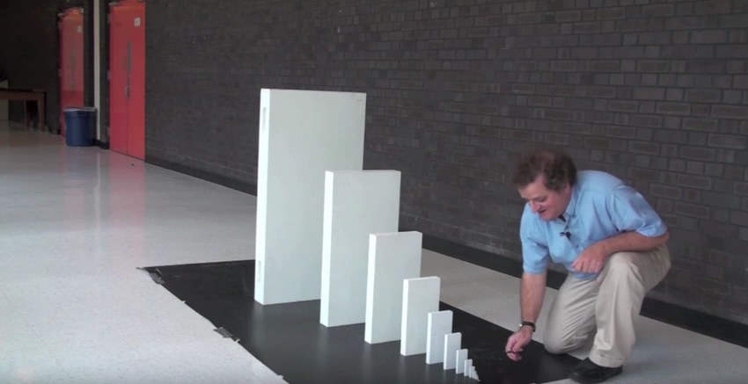
“Don’t be overwhelmed by DevOps nirvana...stay focused on incremental improvements. Each improvement is like a savings deposit that will compound over time”
Notes:
Prepare for a lot of change; be willing to embrace the change; Reflect on why you do things...is it still valid? Was it ever valid?
Your existing skills are becoming obsolete and your expertise is at risk; Find a way to get started on new ideas
“Don’t be overwhelmed by DevOps nirvana...stay focused on incremental improvements. Each improvement is like a savings deposit that will compound over time”

Slide 15
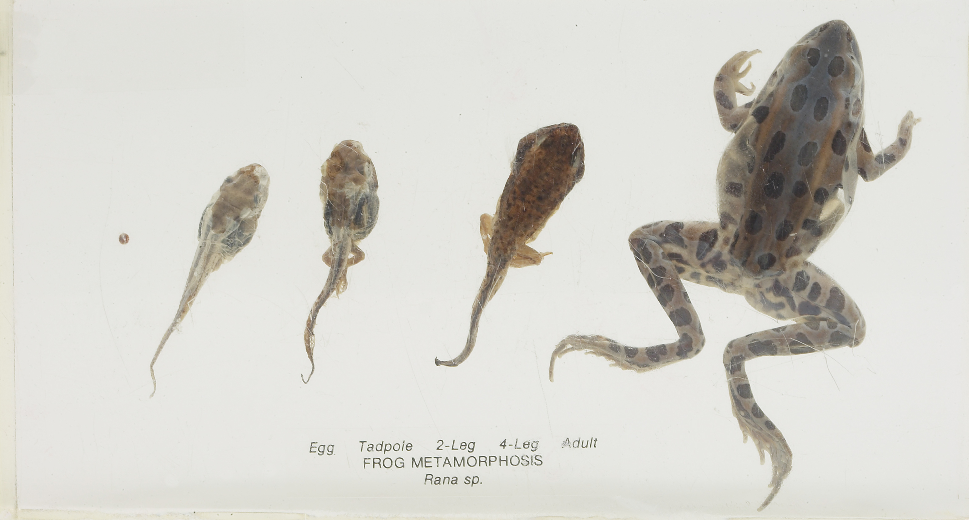
Many veteran “IT Pros” started in help desk, advanced through the ranks, and likely bypassed college.
Notes:
1. Career progression
2. Educational background
3. Vendor certifications
Majority of our team members started on a help desk or operations and have shown that they can learn in the past. How can we rekindle that spark?
Although contemporary biologists have proven a frog that is gradually heated will jump out of boiling water, I think it is still a useful change tactic to periodically change the conditions to challenge the team.
Indeed, thermoregulation by changing location is a fundamentally necessary survival strategy for frogs and other ectotherms.

Slide 16

YOUR mindset matters
Notes:
The role of a leader in the learning organization is that of a designer, teacher, and steward who can build shared vision and challenge prevailing mental models. The leader is responsible for learning.
Here are some questions to reflect on:
Do you believe in your team?
Do you believe each member can get better?
Do you have the humility to let your teams see you going outside your comfort zone? Failing? Learning? Growing?
Are you prepared to lead by example?
In the goal we see activites being structured based on Herbie’s pace (so we don’t leave people behind)...Have you considered the capabilities of the team in structuring your own journey?

Slide 17

“Around 94% of the possible improvements belong to the system (the responsibility of management)” - Deming
Notes:
Many of the DevOps ideas came from Lean Manufacturing applied to a different context. Deming was a Lean thought leader with strong ideas about mgmt.
A manager of people understands that people are different from each other and tries to create for everybody interest and challenge, and joy in work. He tries to optimize the education, skills, hopes, and abilities of everyone.
He is an unceasing learner. He encourages his people to study.
He creates trust. He creates an environment that encourages freedom and innovation. He does not expect perfection.
He understands the benefits of cooperation and the losses from competition between people and between groups.

Slide 18
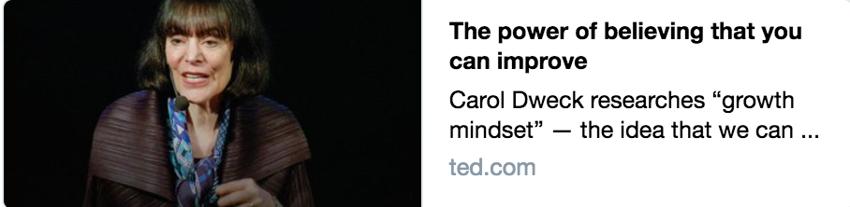
“Let's not waste any more lives¹, because once we know that abilities are capable of such growth, it becomes a basic human right for children², all children², to live in places³ that create that growth, to live in places³ filled with yet.”
¹ careers
² people
³ workplaces
Notes:
Carol Dweck has extensively studied growth mindset. She found that Children typically disengage when they are told they are failures.
Just the words "yet" or "not yet," we're finding, give kids greater confidence, give them a path into the future that creates greater persistence. And we can actually change students' mindsets.
In one study, we taught them that every time they push out of their comfort zone to learn something new and difficult, the neurons in their brain can form new, stronger connections, and over time, they can get smarter.

Slide 19
“Let's not waste any more lives¹, because once we know that abilities are capable of such growth, it becomes a basic human right for children², all children², to live in places³ that create that growth, to live in places³ filled with yet”
¹ careers
² people
³ workplaces
Notes:
Let’s hack this a bit and replace:
Lives with Careers
Children with People
Place with Workplaces

Slide 20
“Let's not waste any more careers, because once we know that abilities are capable of growth, it becomes a basic human right for people, all people, to live in workplaces that create that growth, to live in workplaces filled with yet.”
¹ careers
² people
³ workplaces
Notes:
As leaders in your organization, here is your call to action…
Let's not waste any more careers, because once we know that abilities are capable of growth, it becomes a basic human right for people, all people, to live in workplaces that create that growth, to live in workplaces filled with "yet".

Slide 21

“…Your goal is to pitch the ball where the bat will be…”
- Scott’s Camp Director ~ 1990
Notes:
The next time you pitch I want you to try to put the ball where the bat will be
…can you imagine how the kid will feel if he gets a hit?
...That experience will stay with the kid the entire year and can use it to build other, unrelated skills and confidence
...When the kid strikes out WE miss a critical opportunity to cultivate self-esteem.
Is your transformation putting the ball where the bat will be?
Are you mindfully structuring your activities for inclusion?

Slide 22
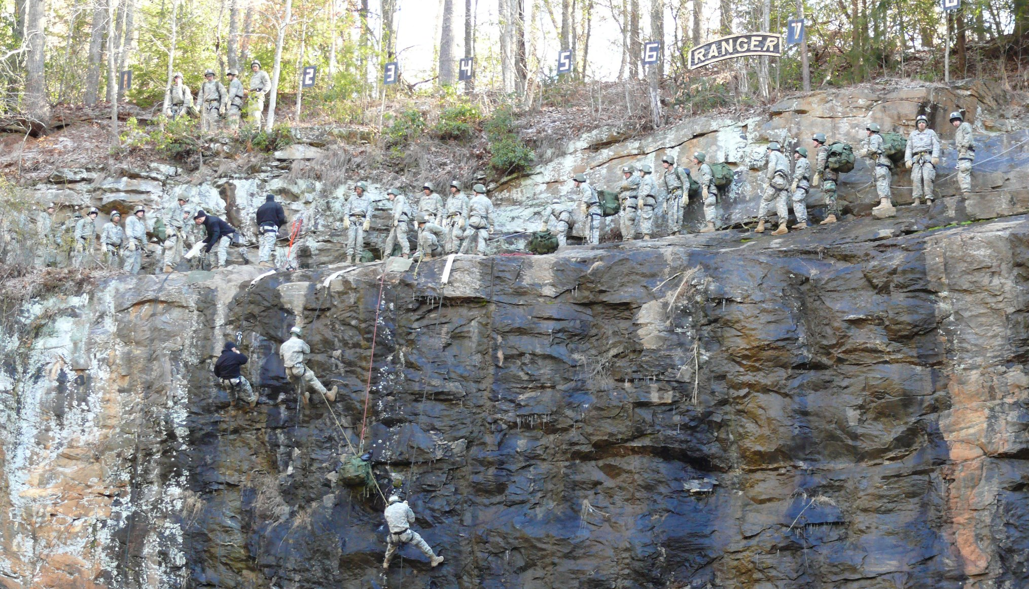
Be a servant leader, Be an adaptive learner
Know Yourself, your people, and your profession
Do the right things right
Notes:
As a former Army officer I have high expectations of leaders and myself.
The principles of Be, Know, Do are just as applicable to a DevOps context...
Be a servant-leader, Be an adaptive learner, Be a creative thinker, Be a global communicator
Know yourself and seek self improvement
Know your people and help them achieve their potential
Know the doctrine, and know when to be constrained by it
Know your profession, contribute to it, and develop with it
Do the right things right
Do provide a clear, actionable vision
Do make timely decisions
Do maintain balance and moderation

Slide 23
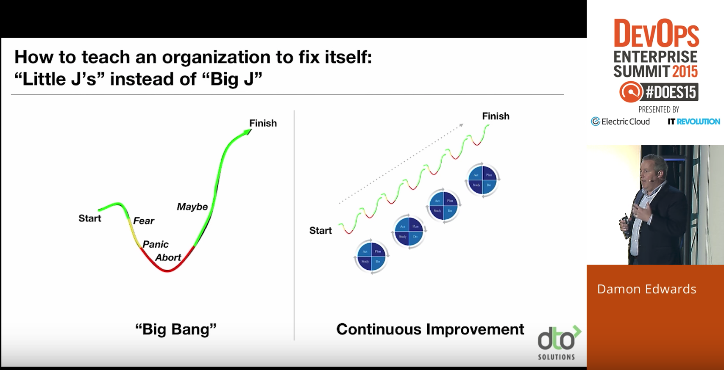
Hypothesis: DevOps practices can teach Microsoft Enterprises to become a learning organization

Slide 24
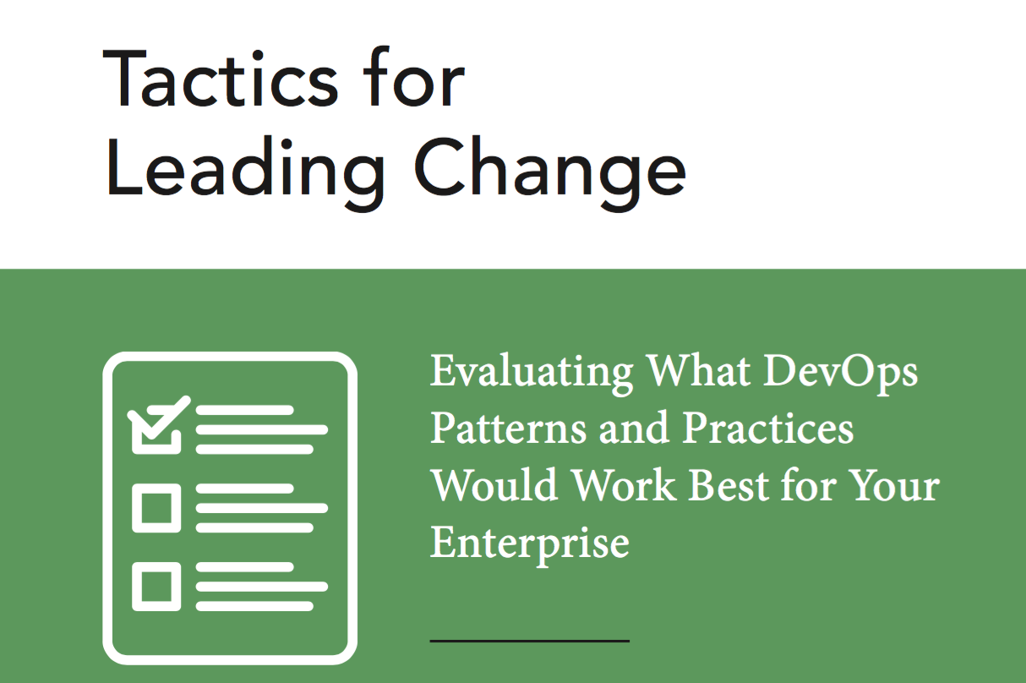
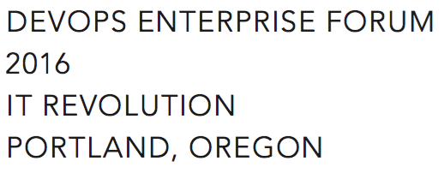
Small batch DevOps®
Make a compelling case for change (Tactic 14)
DevOps information sessions (Tactic 2)
Make Work Visible (Tactic 11) & Common Backlog (Tactic 12)
Propose Experiments (Tactic 4)
Gemba Walks (Tactic 9)
Limit Blast Radius (Tactic 15)
Later
Set WIP Limits (Tactic 13)
Blameless Retrospectives (Tactic 5)
Notes:
Tactics for Leading Change wasn’t available when we started but many of the early patterns are well-represented in the white paper written by the DevOps Enterprise Forum
Without accompanying changes in the way that work gets done, only the potential for improvement exists – David A. Garvin
Make a compelling case for change (Tactic 14)
DevOps information sessions (Tactic 2)
Make Work Visible (Tactic 11) & Common Backlog (Tactic 12)
Propose Experiments (Tactic 4)
Gemba Walks (Tactic 9)
Limit Blast Radius (Tactic 15)
Set WIP Limits (Tactic 13)
Blameless Retrospectives (Tactic 5)

Slide 25
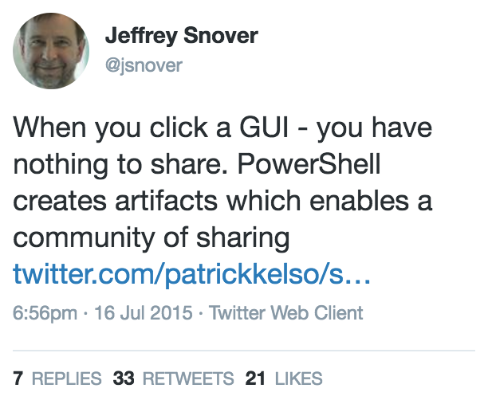
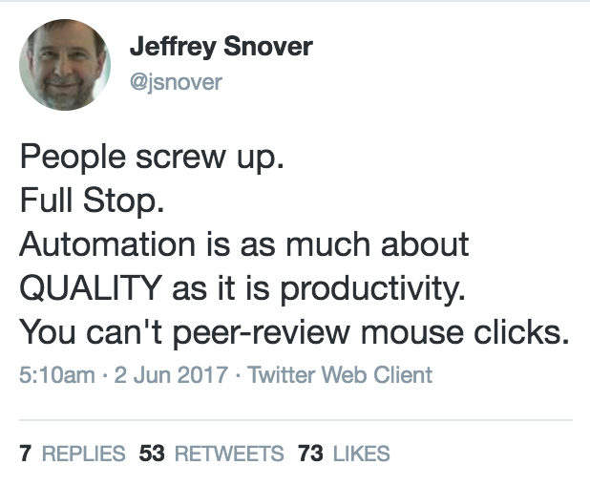
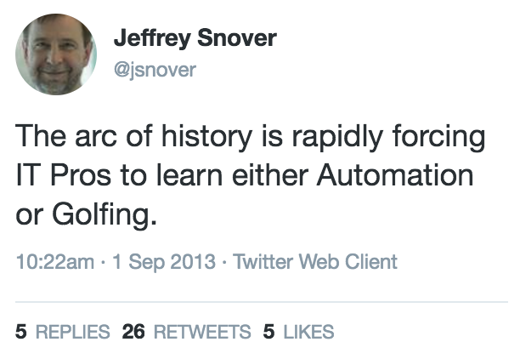
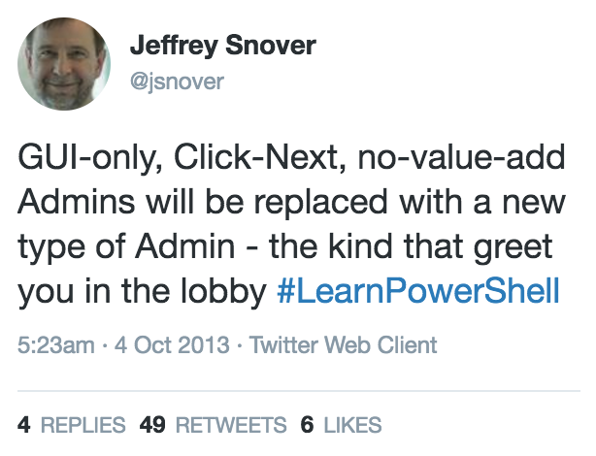
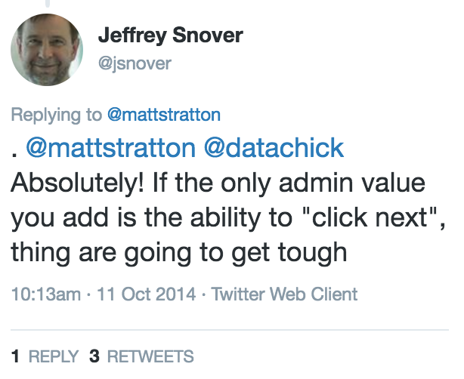
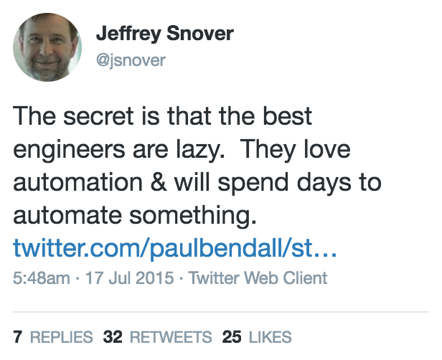

Slide 26
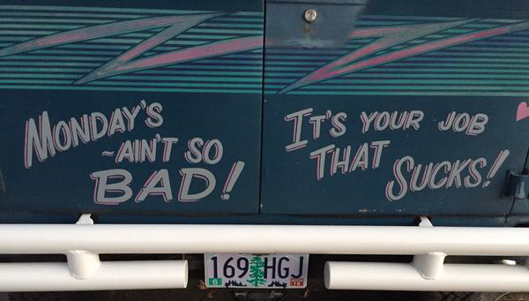
Let’s build better jobs while pursuing a win-win. Let’s go on the journey together.
Notes:
Let’s build better jobs while pursuing a win-win. Let’s go on the journey together.

Slide 27
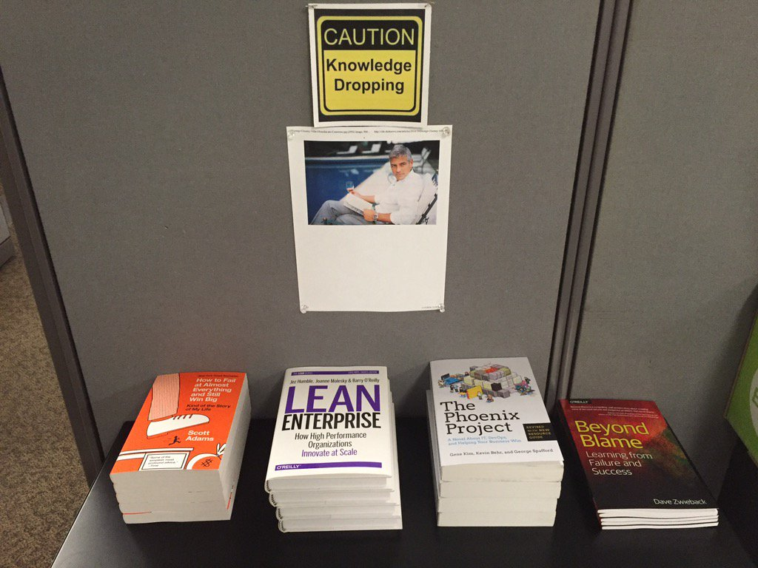
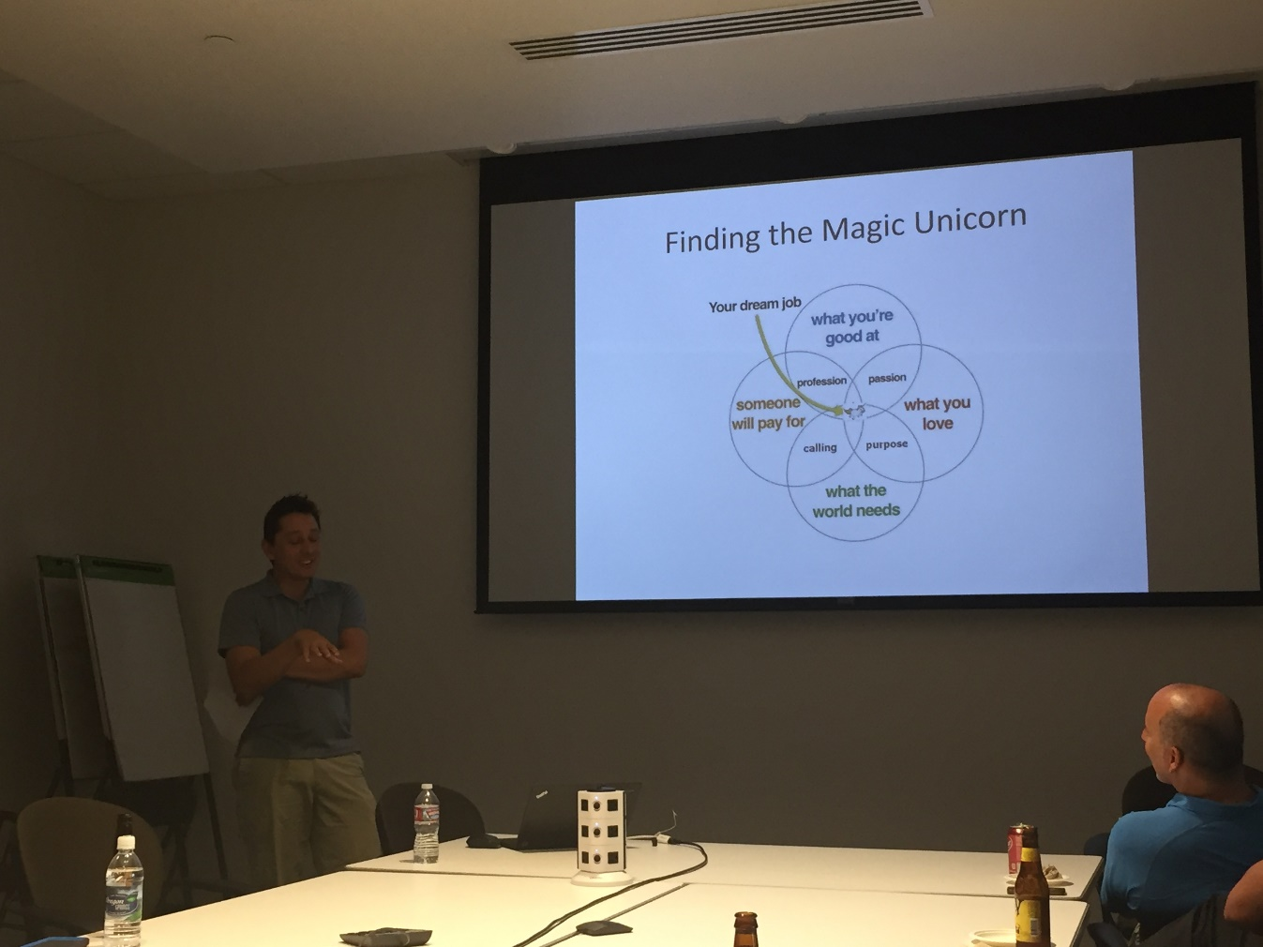
Building curious people

Slide 28
Learning Org progression
Cognitive - 2015
Exposed to new ideas, expand their knowledge and begin to think differently.
Behavioral - 2016
Employees internalize new insights and alter behavior.
Performance Improvement - 2017
Changes in behavior leading to measurable improvements in results.

Slide 29
2015
Q1 Daily Standup → Weekly Standup TFS Kanban TFS Version Control : Goal 250 artifacts Conferences – spread wealth DevOps in a Microsoft World (Snover) Primary / Alternate engineer swaps
Q2 CHEF Conf 2015 x 10 Phoenix Project suggested reading Nordstrom reference calls PS & VMware vCloud Automation Center Prepare Workspace (TFS, .Net, PS, ChefDk) CHEF POC
Q3 Enterprise CHEF contract (700 nodes) Weekly Demos DSC Server provisioning (PoshOrigin) Difficulty stabilizing tools, automation Height of frustration ☹ PowerShell onsite training
Q4 Simplified PoshOrigin: WSIWYG CHEF Greenfield via Server provisioning Automation for ransomware remediation Curious people series Desktop PowerShell module CHEF: 100+ Greenfield Servers 500+ artifacts in version control

Slide 30
2016
Q1 Greenfield N-Tier App with CHEF CHEF onsite training Slack experimentation Work visibility & analytics – TFS + PowerShell Clean up ticketing system Vmware DevOps investigation (vRA, etc.) All in one monitoring solution
Q2 Exploration: PS script consumption Automation: psake, pester, Artifactory Stretched vSAN cluster Data Center migration via automation PowerShell module to manage TFS Kanban Community: DevOpsDays Portland Sponsor CFPs for tech conferences
Q3 Ideas: VelocityConf - ChatOps & Rotations Book: “Team of Teams” McChrystal Organization: Cross functional re-org SCM: GitLab – version control & CI/CD ChatOps: CHEF + Hubot + Slack + GitLab Automation: O365 Exchange in Cloud
Q4 Exploration: scripting for AWS/Azure, EMC Challenges: Loadbalancer pains, SOX 404 CHEF: 500+ Servers & CHEF Automate ChatOps: 150+ scripts, “Etsy Day 1” Friction: Prioritization, Principles Org: Hiring great engineers, rotations

Slide 31
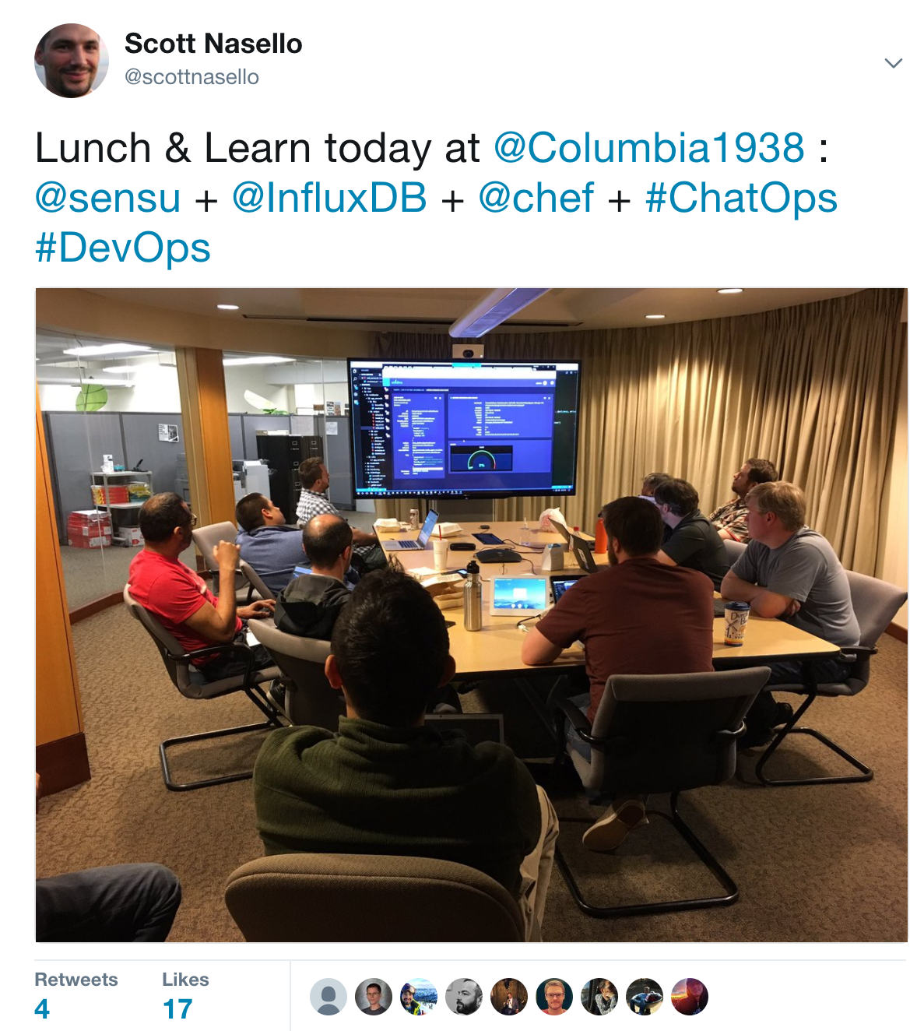
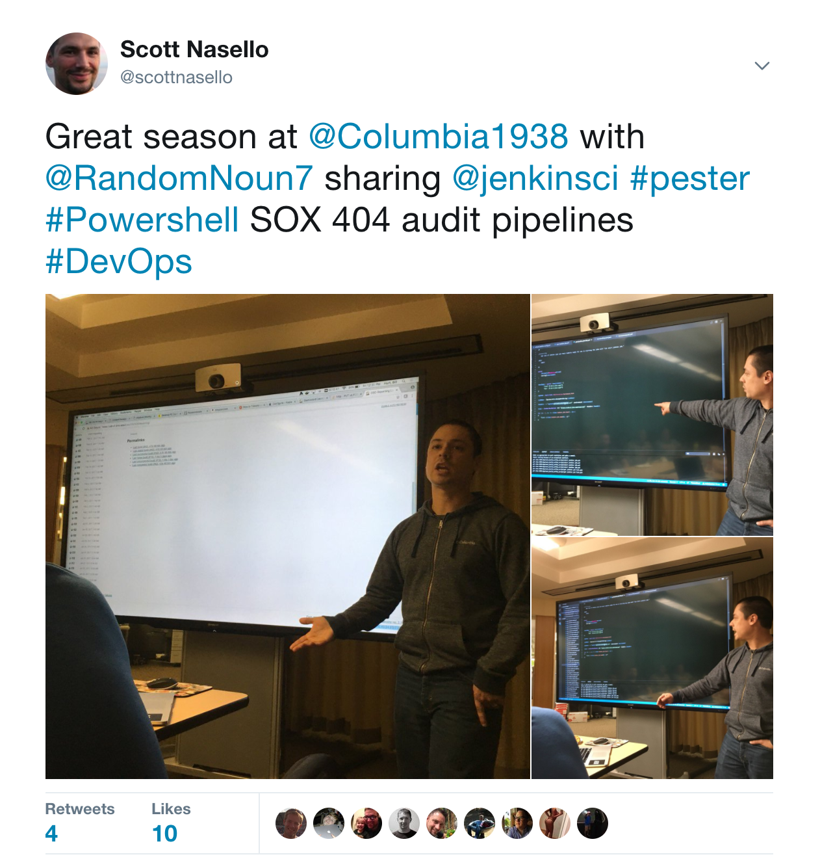
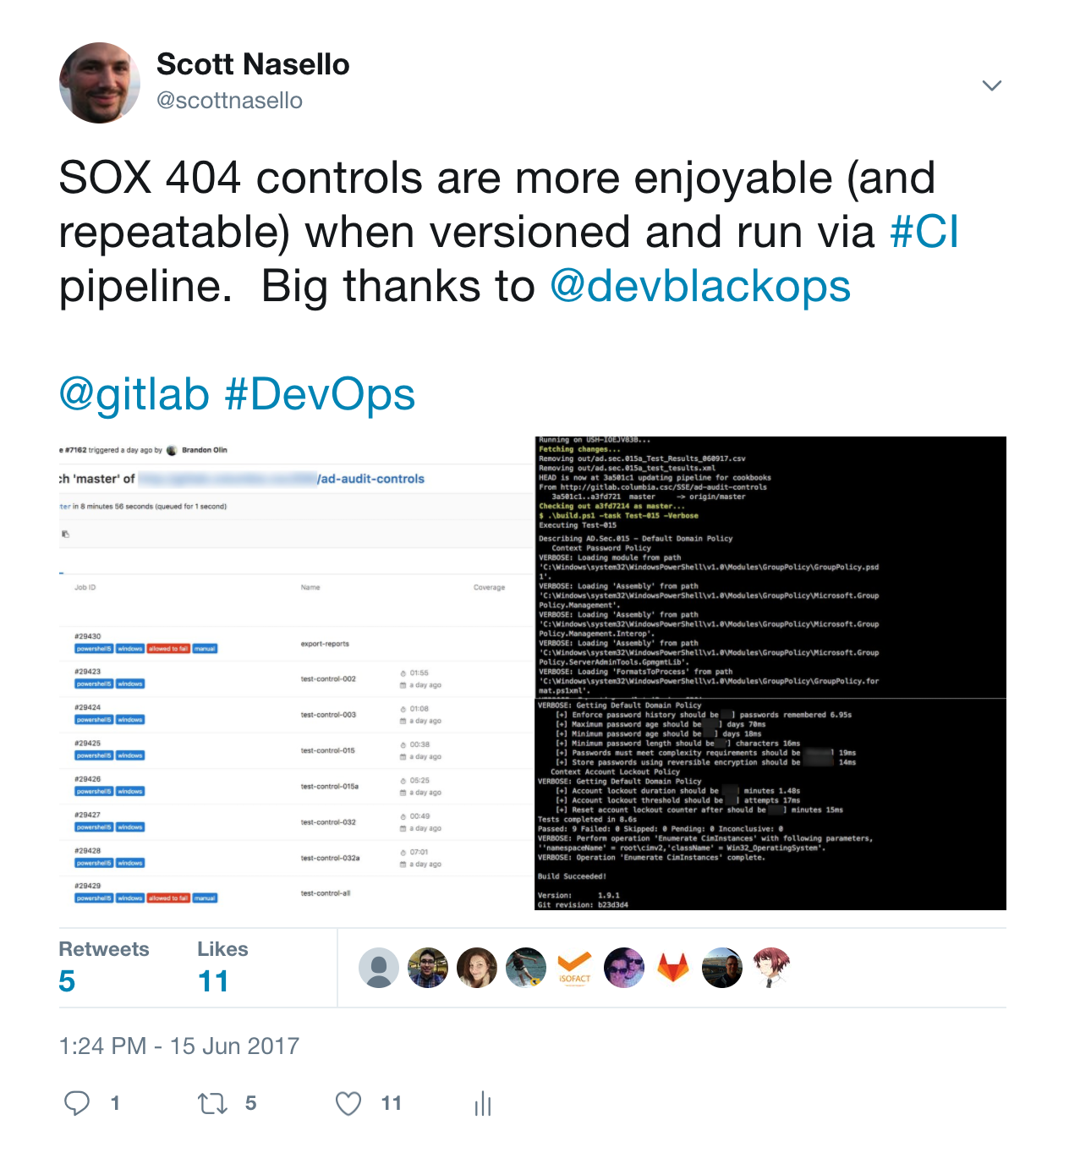
2017
Q1 10 + Azure PaaS POCs SOX 404 Controls as Code Weekly scheduled retrospectives CHEF: 1300+ servers Collaboration with ecommerce team Weekly demos Storage migration via automation/ChatOps
Q2 “Cloud first” orientation Retail CHEF recipe & ChatOps for 3rd party Sensu + InfluxDb + Grafana Coaching applications teams on DevOps Agile Infrastructure Engineering Team Green/Blue NetScaler Loadbalancer design

Slide 32
FROM (circa 2015) | TO
Siloed Experts in specialist teams | “T-shaped” Engineers in cross-functional teams
System Admins w/Point and click behaviors | ”Fuller Stack” engineers using CI pipelines
Individuals optimizing for their function | Team players optimizing for platforms (DFM)
Capable, confident, and complacent | Learning organization; skilled at change
Command & Control leadership | Empowered/Engaged teams (eg. Leader-Leader)
VMware private cloud orientation | Public cloud first orientation
Slow, reactive, and technology hoarding | ChatOps (diffusion, transparency, velocity)
Overreliance on vendors | Loosely coupled technologies, open source
Focus on utilization | Focus on speed (low WIP)
Postmortems (after major outage) | Weekly scheduled retrospectives

Slide 33

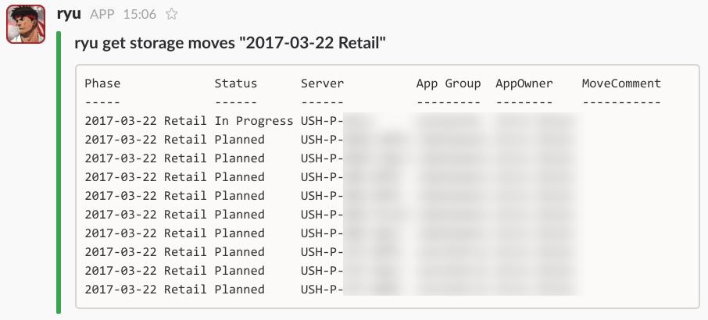
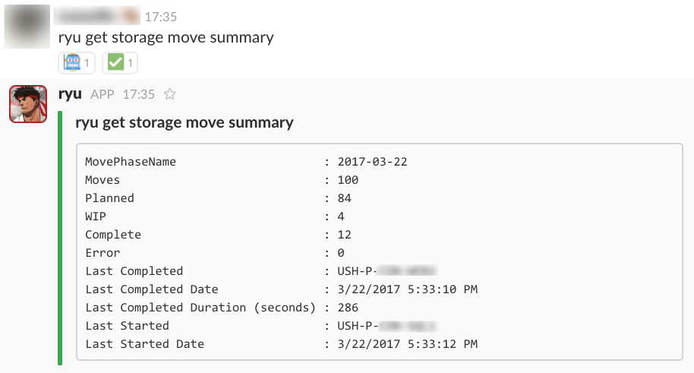
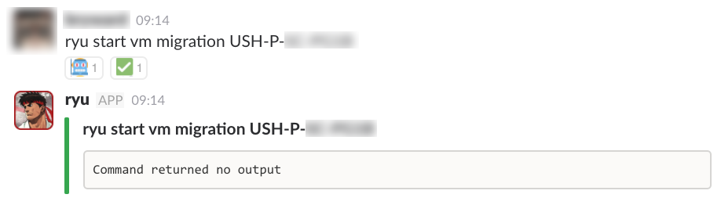
ChatOps: A collaboration workflow that connects people, tools, process, and automation

Slide 34
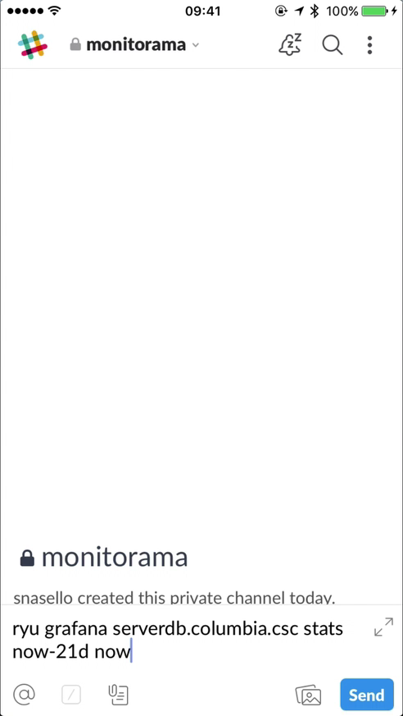
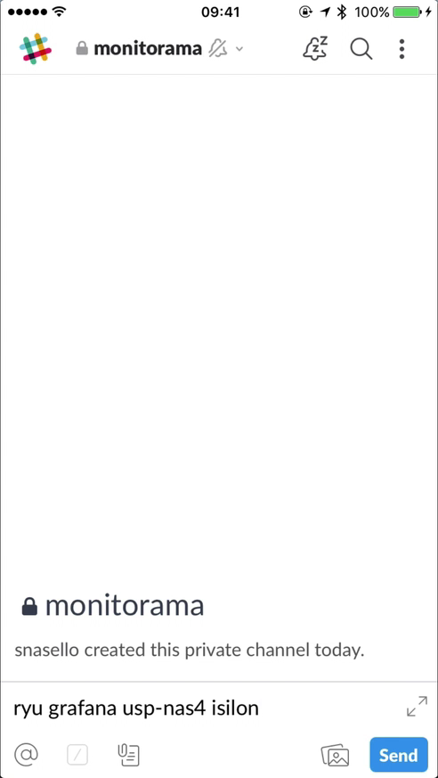
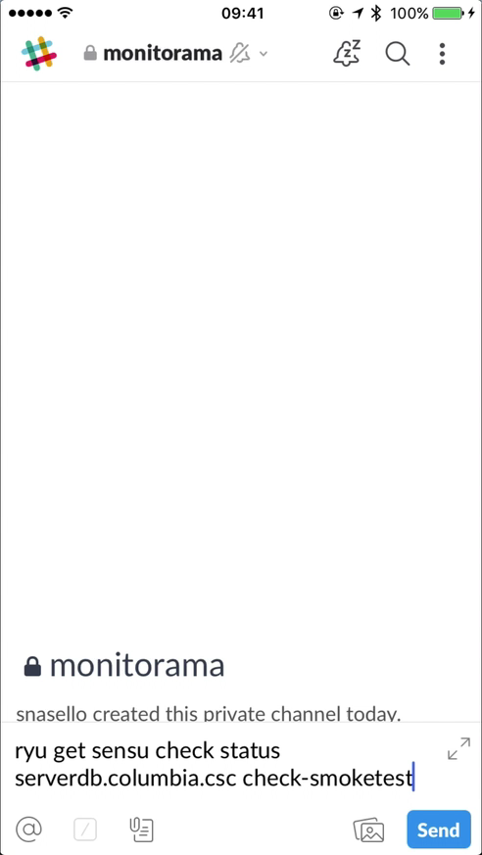
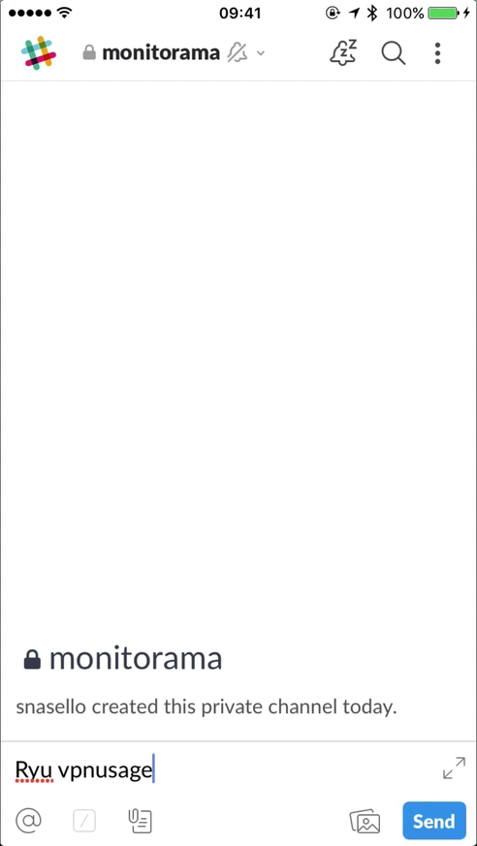
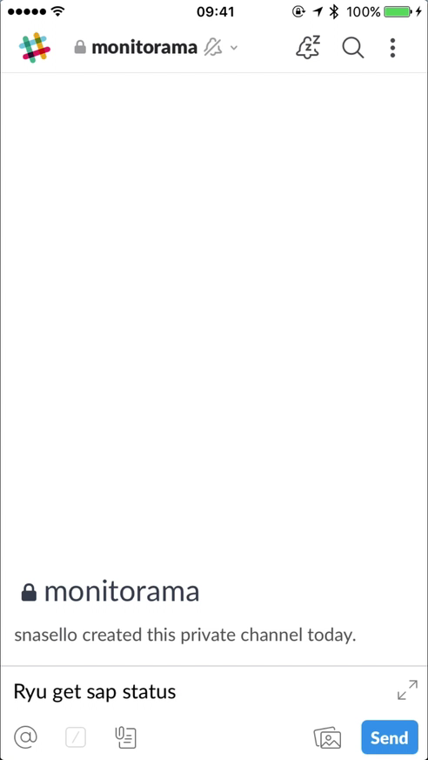
Active Directory, Artifactory, Azure, CHEF, Cisco, Citrix, Commvault, EMC, GitLab, Grafana, InfluxDB, Isilon, Jenkins, Lansweeper, O365, NetScaler, Packer, Palo Alto, Pester, PoshOrigin, SAP, SCCM, Sensu, SharePoint, Symantec, Teradata, Terraform, TFS, VMware, VPN, Windows
1
2
3
4
5
Notes:
These are real ChatOps scripts in our environment. Because the scripts can be run on any device we get transparency, engagement, and collaboration in ways we wouldn't have dreamed of before. 1 & 2 are grafana examples, 3 is a sensu example, 4 was created during a snowday to monitor VPN saturation, 5 was created by our basis manager to monitor SAP landscape health
In fact, ChatOps has arguably had more of an impact on our DevOps momentum over the last 12 months than any other idea.
Our last 4 new hires all developed and deployed a chat script on their first day. (Thanks Etsy)
The great thing about having new hires deploy on day 1 is that we reinforce
how excited we are to have them join. In addition, they feel like they are already contributing.
To make onboarding easier, we developed a process that creates coffee scripts by wrapping powershell. This helps team members come up to speed quicker as it abstracts complexity. Engineers move to coffee when they need more features
ChatOps is a gentle introduction to our technology stack. A they commit their first script we can explain CI/CD, Devops, and other concepts in a hands on manner.
Also we can explain how their script showed up in Chat

Slide 35
Drive out fear – Demming
Improve constantly and forever – Demming
Good ideas are not adopted automatically. They must be driven into practice with courageous impatience. – Admiral H. Rickover
Don’t move information to authority, move authority to the information – Captain Marquet
Notes:
If I ran into our CEO in the hall and he asked me which ideas were most important to our journey I would tell him:
Drive out fear. Create trust and a climate for long term innovation – W Edward Demming
Improve constantly and forever. Quality starts with the intent of management. Management is obligated to continually look for ways to improve quality – W Edward Demming
Good ideas are not adopted automatically. They must be driven into practice with courageous impatience. – Admiral H. Rickover
Don’t move information to authority, move authority to the information - Marquet

Slide 36

Hypothesis: DevOps practices can teach Microsoft all Enterprises to become a learning organization
Notes:
Hopefully you will take away some ideas for how that DevOps practices can cultivate (or reinforce) both a growth mindset for individuals as well as a learning organization for your teams.

Slide 37
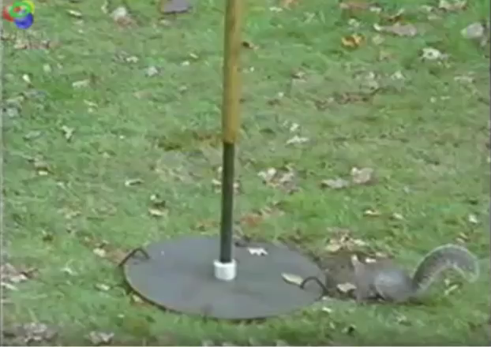
Notes:
How I would describe the journey:
You will take several leaps of faith and you might miss the target
You will periodically be uncomfortable with your surroundings and tasks
You will learn new skills
You will learn to become more adaptable and flexible
You might learn to drive a rocket
If you stick with it you will be glad you went on the journey

